Slide 1
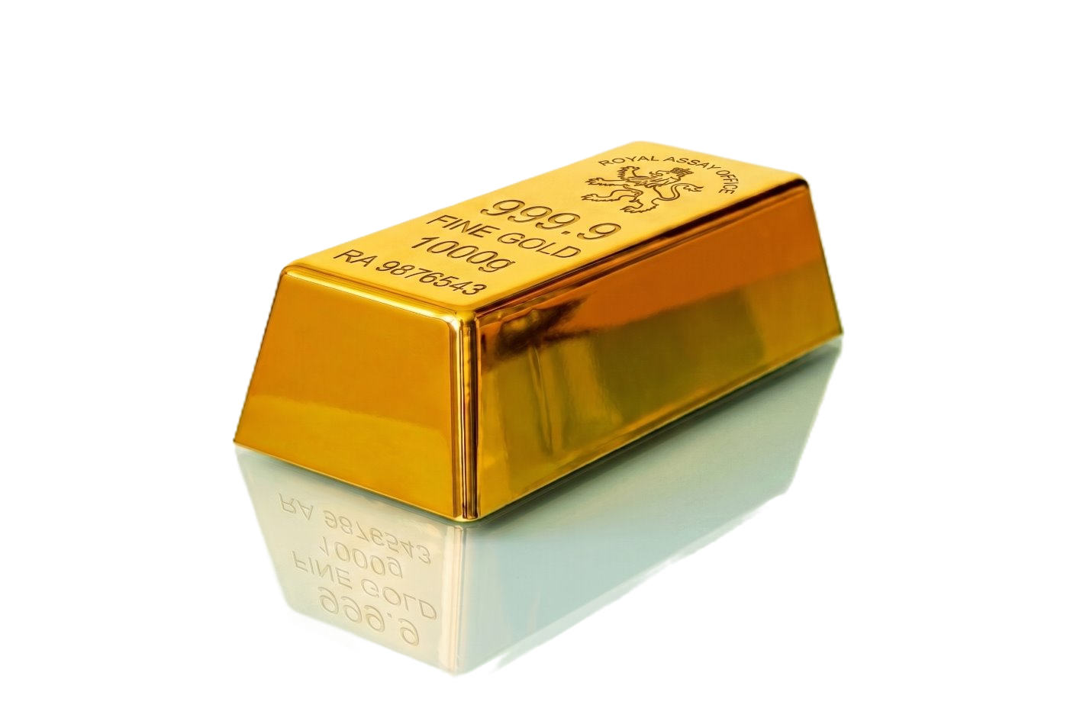
Physical Precious Metals Program
Allocate, trade, and report physical precious metals inside the workflows you already use — no new accounts, no new logins, no operational lift.
CLIENT VALUE & ASSET RETENTION
Keep It on Platform
Client precious metals allocations held, reported, and billed through your existing ecosystem. No leakage to retail dealers or contra firms.
CUSTODY
Streamlined Reporting
Physical bullion positions appear on monthly client statements like any other holding. Daily valuations can be monitored in real time, with consolidated reporting and full audit trails accessible through standard portfolio management workflows.
✓
1:1 Allocation no shared ownership
✓
Quarterly physical audits
Best Execution, Every Trade
12+ institutional dealers and refiners bid on every order resulting in no inventory bias and competitive spreads. Clients get institutional pricing, transparent execution, and intraday liquidity.
✓
Fully insured and fully deliverable
FOR YOUR FIRM
VAULTING INFRASTRUCTURE
(Lloyd's of London Insured)
No New Workflows
Secure, Allocated Custody
Product Standards
Place orders from your existing system. Physical metals integrate with your current billing, reporting, and fee schedule. No internal infrastructure to build, manage, or maintain.
Every bar and coin allocated on a 1:1 basis, physically audited, and fully insured. Full chain of integrity from execution to storage to delivery — through Brink's, Loomis, and Malca-Amit.
All bars manufactured by LBMA and COMEX recognized refineries, plus sovereign-issued coins. Every bar and coin hold the highest standard of recognized provenance and acceptability in global institutional markets.
DOMESTIC HUBS
INTERNATIONAL HUBS
New York • SLC • Dallas
London • Zurich • Singapore

